Slide 1
Data Serving for Analytics and ML
Pravin Y Pawar
Adapted from
Fundamentals of Data Engineering
By Joe Reis and Matt Housley

Slide 2
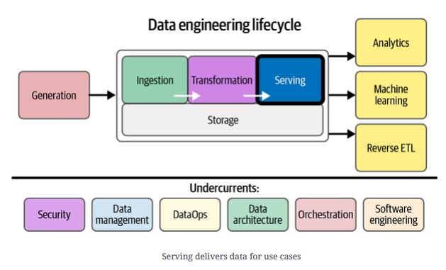
Data Serving

Slide 3
Data Serving
Three Ways
Serve data for analytics and BI
most traditional area of data serving
prepare data for use in statistical analysis, reporting, and dashboards
important as ever for stakeholders to have visibility into the business, organizational, and financial processes
Serve data for ML applications
ML is not possible without high quality data, appropriately prepared
work with data scientists and ML engineers to acquire, transform, and deliver the data necessary for model training
Serve data through reverse ETL
process of sending data back to data sources
For example, might acquire data from an adtech platform, run a statistical process on this data to
determine cost-per-click bids, and then feed this data back into the ad tech platform

Slide 4
Analytics
Discovering, exploring, identifying, and making visible key insights and patterns within data
Carried out using statistical methods, reporting, BI tools, and more
Business Analytics
uses historical and current data to make strategic and actionable decisions
types of decisions tend to factor in longer-term trends and often involve a mix of statistical and trend analysis, alongside domain expertise and human judgment
typically falls into a few big areas—dashboards, reports, and ad hoc analysis
Operational Analytics
uses data to take immediate action:
Operational analytics versus business analytics = immediate action versus actionable insights
big difference between operational and business analytics is time
as real-time updates can be impactful in addressing a problem when it occurs
The line between business and operational analytics has begun to blur!
Embedded Analytics
Whereas business and operational analytics are internally focused, a recent trend is external-facing or embedded analytics
With so much data powering applications, companies increasingly provide analytics to end users
Typically referred to as data applications, often with analytics dashboards embedded within the application itself
The landscape of embedded analytics is snowballing, and expect that such data applications will become increasingly pervasive within the next few years.

Slide 5
Machine Learning
ML is increasingly common!
ML engineering is rising (itself almost a parallel universe to data engineering)
Boundary between ML, data science, data engineering, and ML engineering is increasingly fuzzy, and
this boundary varies dramatically between organizations
In some organizations, ML engineers take over data processing for ML applications right after
data collection or may even form an entirely separate and parallel data organization that handles
the entire lifecycle for all ML applications.
Data engineers handle all data processing in other settings and then hand off data to ML engineers for model training
Data engineers may even handle some extremely ML-specific tasks, such as featuarization of data

Slide 6
Reverse ETL
Today, reverse ETL is a buzzword that describes serving data by loading it from an OLAP database back into a source system
increasingly recognized as a formal data engineering responsibility
For example,
A data engineer might pull customers and order data from a CRM and store it in a data warehouse
This data is used to train a lead scoring model, whose results are returned to the data warehouse
Company’s sales team wants access to these scored leads to try to generate more sales
Have a few options to get the results of this lead scoring model into the hands of the sales team
Can put the results in a dashboard for them to view
Or might email the results to them as an Excel file
The challenge with these approaches is that they are not connected to the CRM, where a salesperson does their work
Why not just put the scored leads back into the CRM?
Using reverse ETL and loading the scored leads back into the CRM is the easiest and best approach for this data product
Reverse ETL takes processed data from the output side of the data engineering lifecycle and feeds it back into source systems

Slide 7
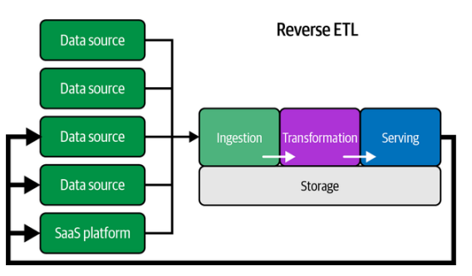
Reverse ETL(2)

Slide 8
Ways to Serve Data for Analytics and ML
File Exchange
Is ubiquitous in data serving. We process data and generate files to pass to data consumers
A data scientist might load a text file (unstructured data) of customer messages to analyze the
sentiments of customer complaints
A business unit might receive invoice data from a partner company as a collection of CSVs (structured data)
An analyst must perform some statistical analysis on these files
The way files are served depends on several factors, such as these:
Use case — business analytics, operational analytics, embedded analytics
The data consumer’s data-handling processes
The size and number of individual files in storage
Who is accessing this file
Data type — structured, semi-structured, or unstructured

Slide 9
Ways to Serve Data for Analytics and ML(2)
Databases
Critical layer in serving data for analytics and ML - serving data from OLAP databases (e.g.,data
warehouses and data lakes)
Serving data involves querying a database and then consuming those results for a use case
An analyst or data scientist might query a database by using a SQL editor and export those results to a CSV
file for consumption by a downstream application, or analyze the results in a notebook
Carries a variety of benefits
A database imposes order and structure on the data through schema
Databases can offer fine-grained permission controls at the table, column, and row level, allowing database
administrators to craft complex access policies for various roles
Databases can offer high serving performance for large, computationally intensive queries and high query
concurrency
A data scientist might connect to a database, extract data, and perform feature engineering and
selection
Converted dataset is then fed into an ML model
offline model is trained and produces predictive results
Data engineers are quite often tasked with managing the database-serving layer.

Slide 10
Ways to Serve Data for Analytics and ML(3)
Streaming Systems
Increasingly important in the realm of serving
type of serving may involve emitted metrics, which are different from traditional queries
Operational analytics databases playing a growing role in this area
allow queries to run across a large range of historical data, encompassing up-to-the-second current data
combine aspects of OLAP databases with stream-processing systems
increasingly work with streaming systems to serve data for analytics and ML, so get familiar with this paradigm

Slide 11
Ways to Serve Data for Analytics and ML(4)
Query Federation
Query federation pulls data from multiple sources, such as data lakes, RDBMSs, and data
warehouses
becoming more popular as distributed query virtualization engines gain recognition as ways to serve queries
without going through the trouble of centralizing data in an OLAP system
Trino and Presto and managed services such as Starburst
End user might be querying several systems—OLTP, OLAP, APIs, filesystems, etc.
Instead of serving data from a single system, now serving data from multiple systems, each with its usage
patterns, quirks, and nuances
If federated queries touch live production source systems, need to ensure that the federated query won’t
consume excessive resources in the source
Federation allows ad hoc queries for performing exploratory analysis, blending data from various
systems without the complexity of setting up data pipelines or ETL
Federated queries also provide read-only access to source systems, which is great when you don’t want to
serve files, database access, or data dump
The end user reads only the version of the data they’re supposed to access and nothing more
Query federation is a great option to explore for situations where access and compliance are critical

Slide 12
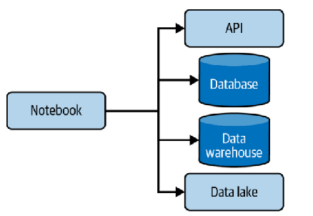
Ways to Serve Data for Analytics and ML(5)
Serving Data in Notebooks
Data scientists often use notebooks in their day-to-day work
for exploring data, engineering features, or training a model
Jupyter Notebook, along with its next-generation iteration,
JupyterLab
open source and can be hosted locally on a laptop, on a
server, or through various cloud-managed services
Jupyter stands for Julia, Python, and R
Data scientists will programmatically connect to a data
source, such as an API, a database, a data warehouse, or a
data lake
In a notebook, all connections are created using
the appropriate built-in or imported libraries to load a file from a
filepath
connect to an API endpoint
or make an ODBC connection to a database

Slide 13
Thank You!
In our next session:

